Slide 1


BSC (Hons)Computing Final Project Viva
Name: Kamaldeen Dilshad Hussain
London Met ID No: E026526
Supervisor: Mrs. Sampa

Slide 2
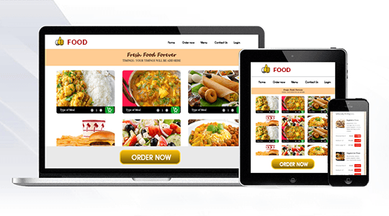
Online Food Ordering System

Slide 3
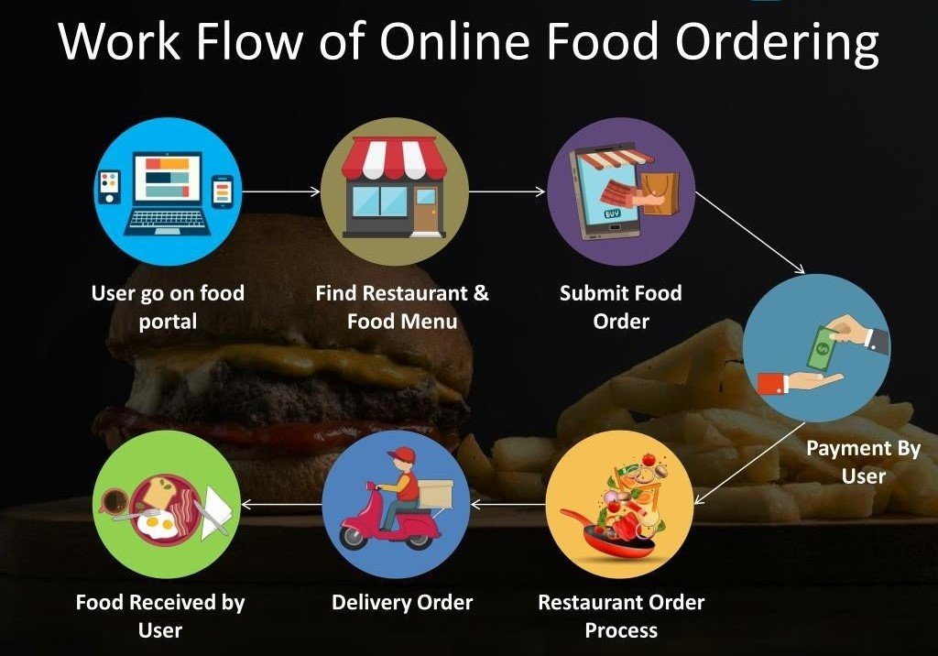
What is Online Food Ordering System?
Online food ordering is a system for delivering a food restaurant to users using websites or mobile apps. If any user wants to get food from home, without traveling and not wasting time he/she orders food online using the web and app.
Nowadays more people are ordering food from a restaurant instead of cooking at home. Every restaurant owner wants to build an online food ordering system like UberEats. The online ordering system is helpful for both users and restaurant owners.

Slide 4
Abstract
ONLINE FOOD DELIVERY SYSTEM is a website designed primarily for use in the food delivery industry.
This system will allow hotels and restaurants to increase scope of business by reducing the labor cost involved.
The system also allows to quickly and easily manage an online menu which customers can browse and use to place orders with just few clicks.
Restaurant employees then use these orders through an easy to navigate graphical interface for efficient processing.

Slide 5
Introduction
In today’s age of fast food and take-out, many restaurants have chosen to focus on quick preparation and speedy delivery of orders rather than offering a rich dining experience.
Until very recently, all of these delivery orders were placed over the phone, but there are many disadvantages to this system, including the inconvenience of the customer needing to have a physical copy of the menu, lack of a visual confirmation that the order was placed correctly, and the necessity for the restaurant to have an employee answering the phone and taking orders.

Slide 6
Proposed System
Provide an admin panel to manage and update the orders.
Remote access to the Customers to place order.
Customer have access to give feedback.
Quickly place order.
No misunderstanding between customer and Waiter.

Slide 7
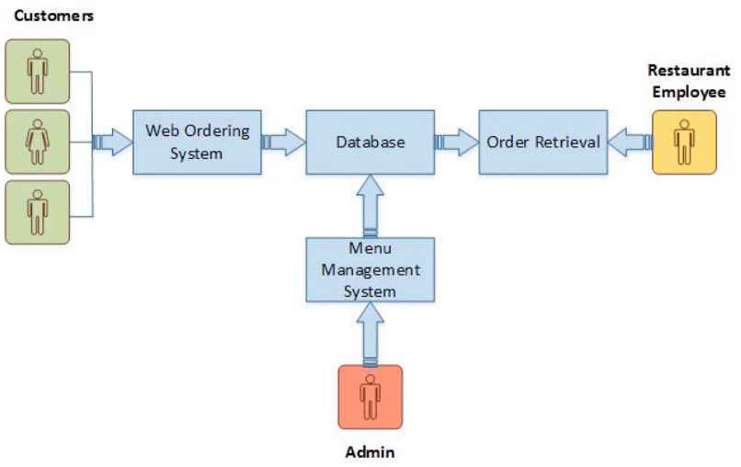
System Model
This module provides the functionality for customers to place their order and supply necessary details.
Menu Management-allows the restaurant to control what can be ordered by the customers
Order Retrieval System-This is a final logical component. Allows restaurant to keep track of all orders placed. This component takes care of order retrieving and displaying order information.

Slide 8
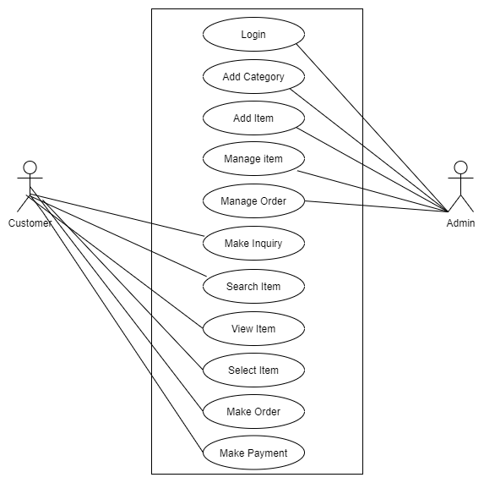
Use Case Diagram

Slide 9
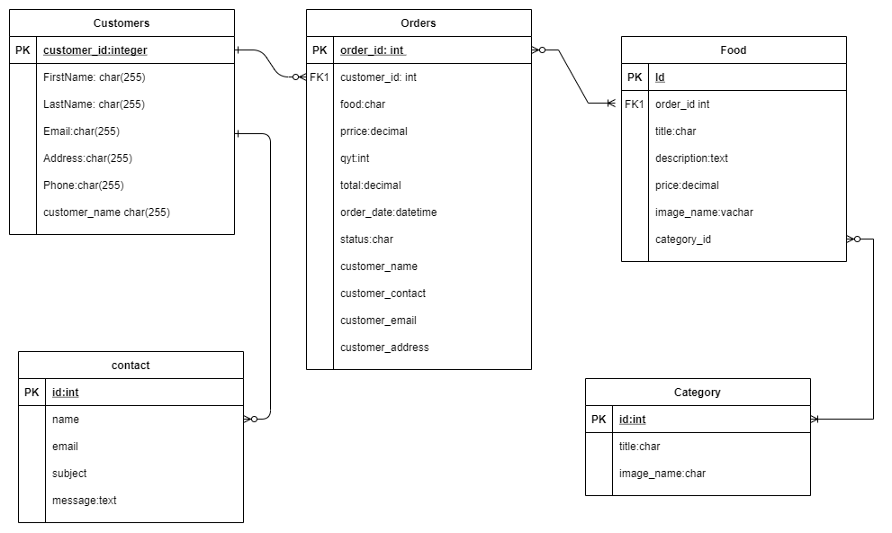
Database Design

Slide 10
Requirements
Software
Operating system- Windows 10
Code Editor - Visual Studio Code
Development Language- PHP
Database – MySQL Server
Web Browser- Google Chrome
Hardware
Processor- intel core i5
Hard Drive- 1TB
RAM- 4 GB

Slide 11
Thank You…..

